Slide 1
Git & GitHub
Avinash Rath

Slide 2
What is Git?
Git is a free and open source distributed version control system designed to handle everything from small to very large projects with speed and efficiency.

Slide 3
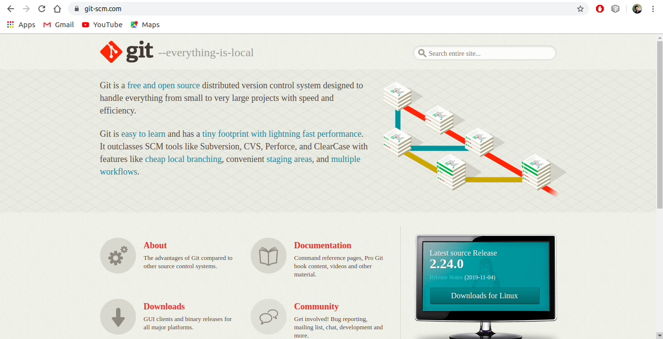

Slide 4

I’ll do you one better….
Why is Git?

Slide 5
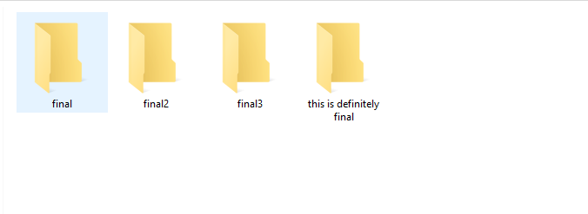
Let’s get some context… shall we?

Slide 6
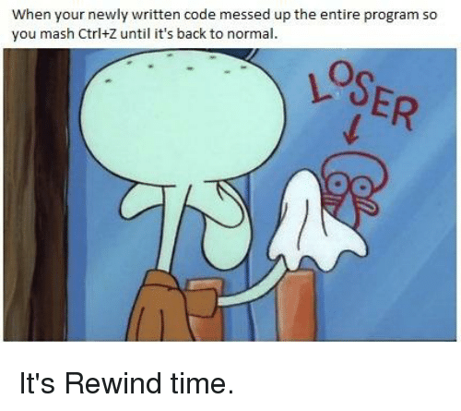



Imagine working in a group of people

Slide 7
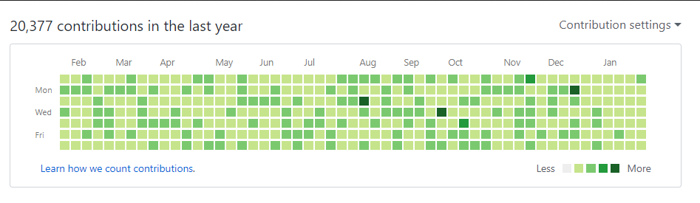

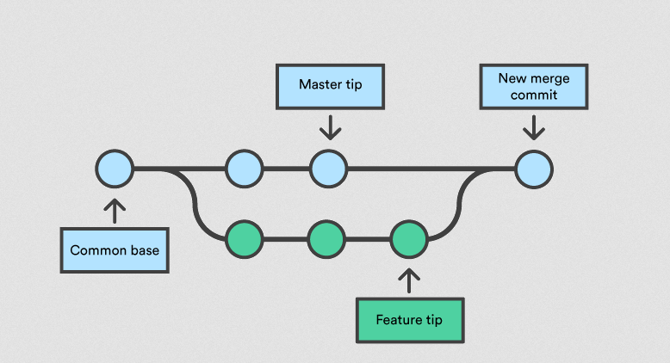
How Git solves the issue?
Repositories
Commits
Branches

Slide 8

Repositories (a.k.a. repos)
A Git repository is the .git/ folder inside a project. This repository tracks all changes made to files in your project, building a history over time. Meaning, if you delete the .git/ folder, then you delete your project’s history.

Slide 9
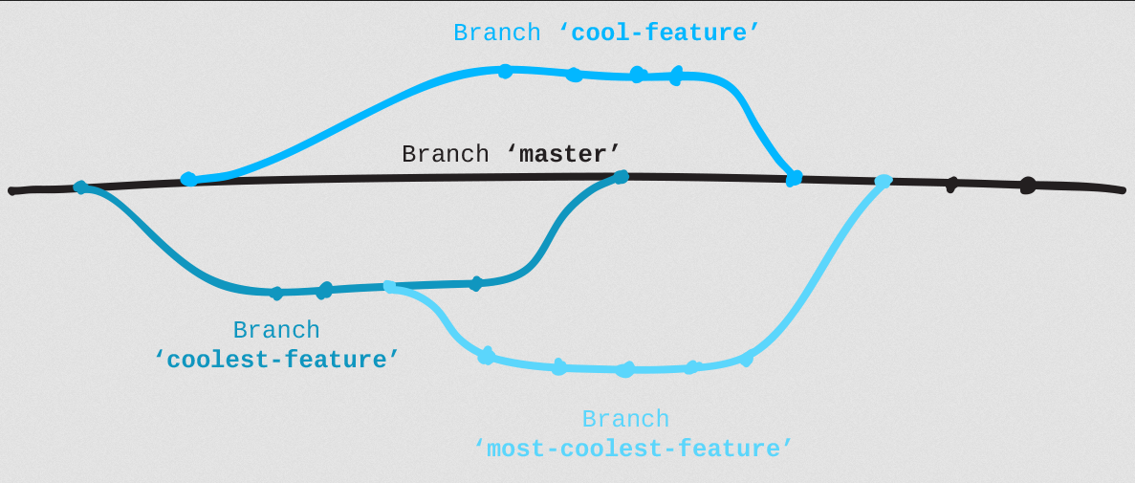
Branches

Slide 10
Commits
The git commit command captures a snapshot of the project's currently staged changes. Committed snapshots can be thought of as “safe” versions of a project
It also keeps track of the author and the time while commiting. Think of it as creating a log or history.

Slide 11

What is GitHub?
GitHub is a code hosting platform for collaboration and version control.
GitHub lets you (and others) work together on projects.

Slide 12
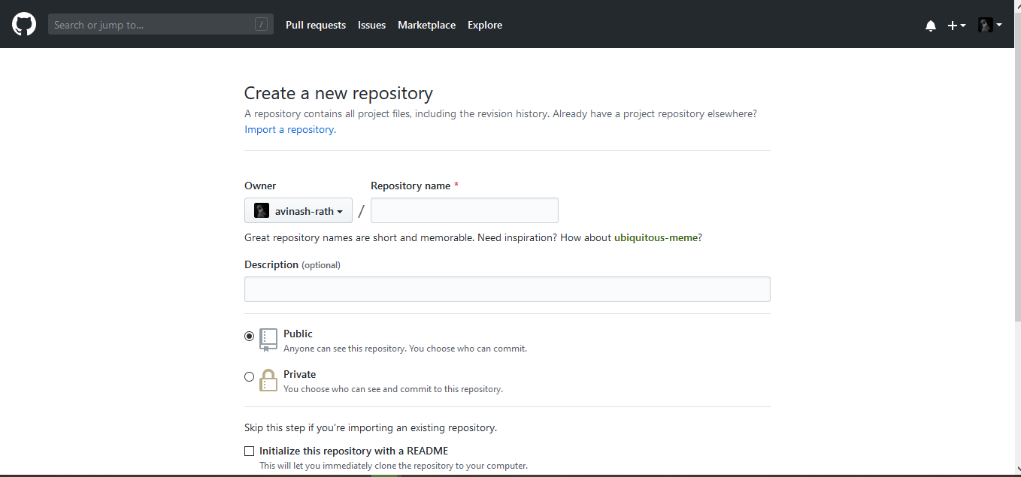
Making a Repository

Slide 13
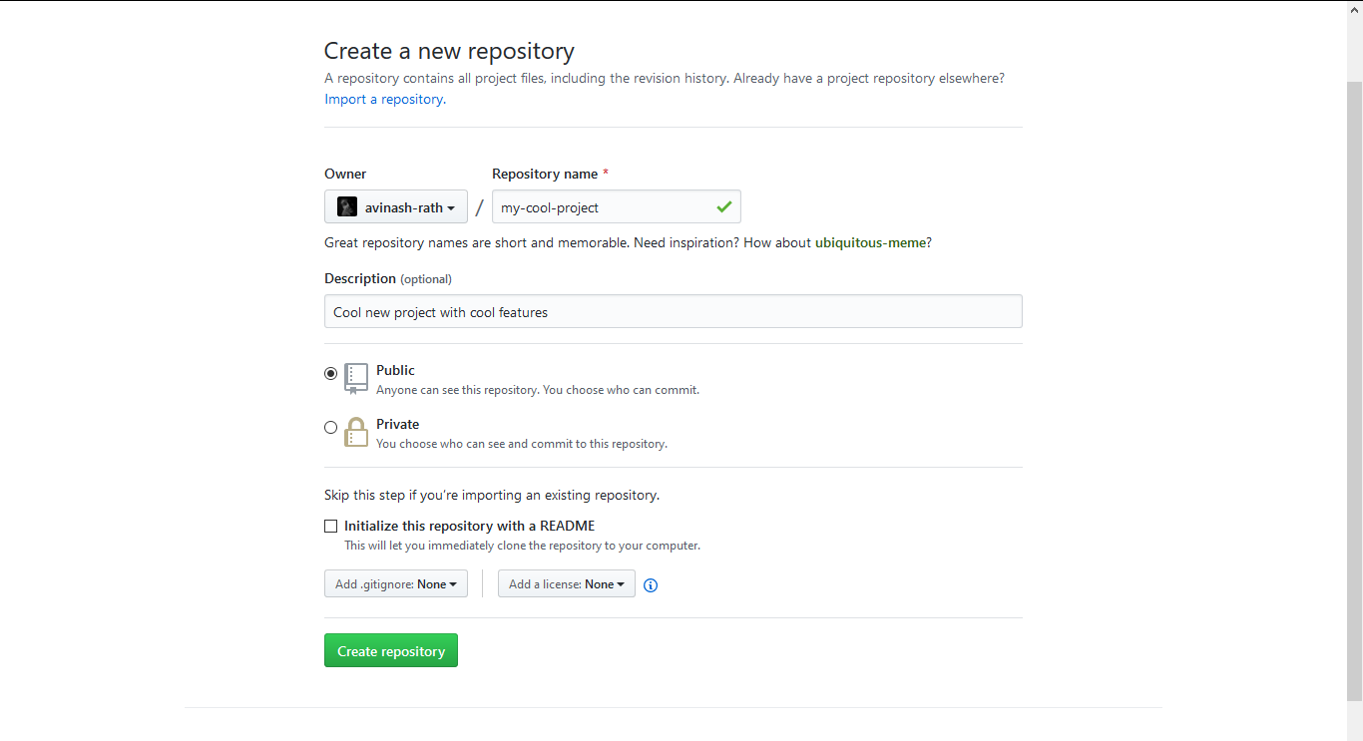

Slide 14
Cloning a Repository
Let’s do it live!

Slide 15
Let’s make some changes to a repo on our pc

Slide 16
Taking a look at branches

Slide 17
How to contribute in open source?
Pull Requests! And merging!

Slide 18
Let’s Sync the changes in

Slide 19
THANK YOU!

